Slide 1

Bot Framework Composer
Gosia Borzecka
AI MVP
O365 Developer

Slide 2
Agenda
What are bots?
Bot Framework
Bot Framework Composer:
How to start?
How to build?
How to publish?

Slide 3
What are bots?
Application that performs an automated task
Conversional interface
Go where your audience is
Supporting bot technology is maturing

Slide 4
Most popular chatbots
Siri
Google Now
Alexa
Cortana
Messanger

Slide 5
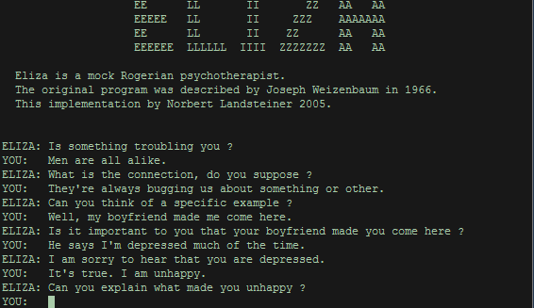
Are bot something new?
1950
The Turing Test
1966
Eliza
1972
Parry
1988
Jabberwacky
1992
Dr. Sbaisto
1995
Alice
Notes:
1950 – The Turing Test – Alan Turing theorized that a truly intelligent machine would be distinguishable from a human during a text-only conversation. These ideas essentially laid the foundations for the chatbot revolution
1966 – Eliza – Eliza was created at the MIT AI Laboratory to simulate human conversation by matching user prompts to scripted responses. It gave an illusion of understanding but had no built in framework for contextualising events.
1972 – Parry – While Eliza was a tongue-in-cheek simulation of a therapist, Parry simulated a person with paranoid schizophrenia. It embodied a conversational strategy and was much more serious than Eliza
1988 – Jabberwacky – Developed in the 1980s and released online in 1997, the Jabberwackychat bot was designed to “simulate natural human chat in an interesting, entertaining and humorous manner”
1992 – Dr. Sbaitso – An AI speech synthesis program created for ms dos-based pcs. Dr. Sbaitso assumed the role of a psychologist when interacting with others and was designed to showcase a digitized voice
1995 – Alice – The “Artificial Linguactic Internet Computer Entity” was a nautral language processing bot. She could apply heuristic pattern matching rules to human input in order to have a conversation, but was still not able to pass the turing test

Slide 6
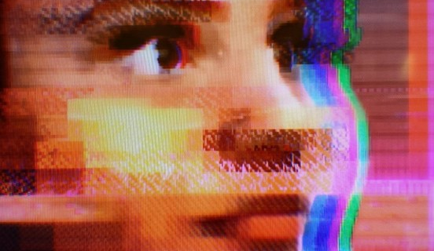
Are bots something new?
2006
IBM’s Watson
2010
Siri
2012
Google Now
2015
Alexa
2015
Cortana
2016
Bots for messenger
2016
Tay

Slide 7
Conversional AI
AI agents participate in conversations with humans

Slide 8

Bot Framework

Slide 9

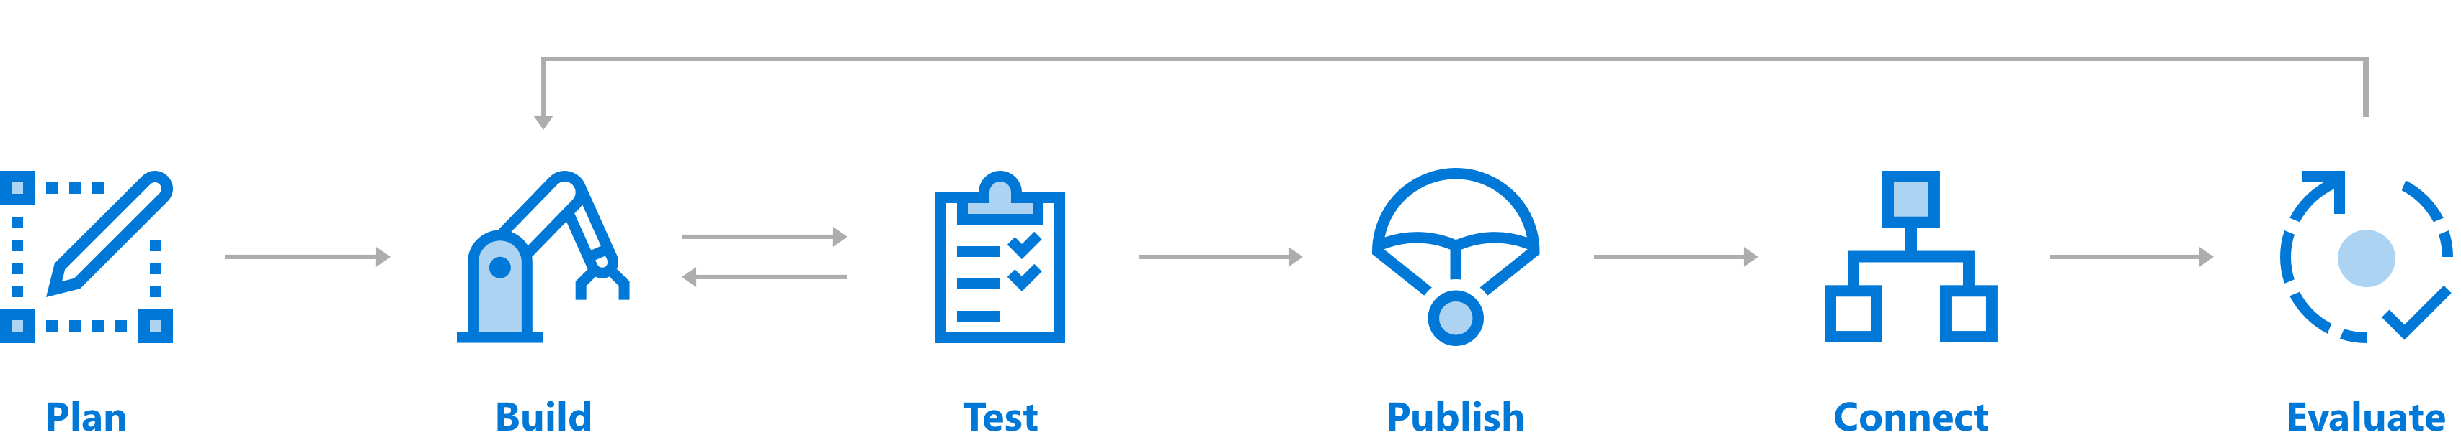
Design Your bot

Slide 10
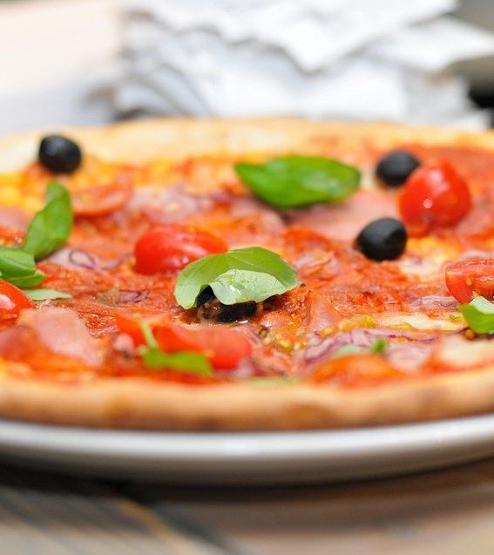
Pizza order bot
Greet user
Ask user what they wish to order
User selects pizza
Prompt for pizza size
Prompt for dough or crust type
Prompt for sauce type
Prompt for topping on
Ask if an additional topping is desired
If user answers yes, prompt for additional topping
Design bot navigation - Learn | Microsoft Docs

Slide 11
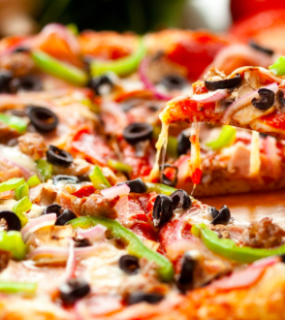
Pizza order bot
Repeat until user is done with toppings
Prompt for cheese type
Prompt for cheese coverage (full, half, etc.)
Prompt for side orders
Repeat until no more side orders desired
Prompt for pickup or delivery
Prompt for payment
Confirm order
End conversation
Design bot navigation - Learn | Microsoft Docs
This Photo by Unknown Author is licensed under CC BY-NC

Slide 12
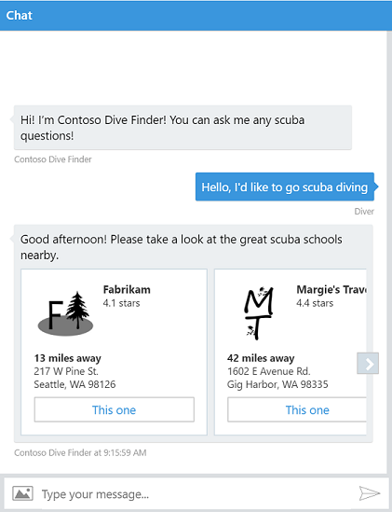
Design the user experience
Text
Speech
Rich user controls
Adaptive Cards
Audio
Animation
Carousel
Sign In
Video
Suggested Action

Slide 13
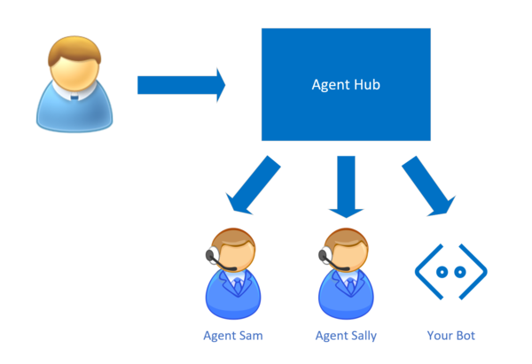
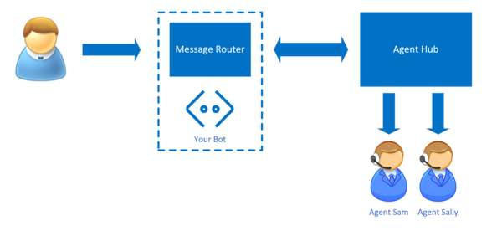
Design hand-off to humans

Slide 14
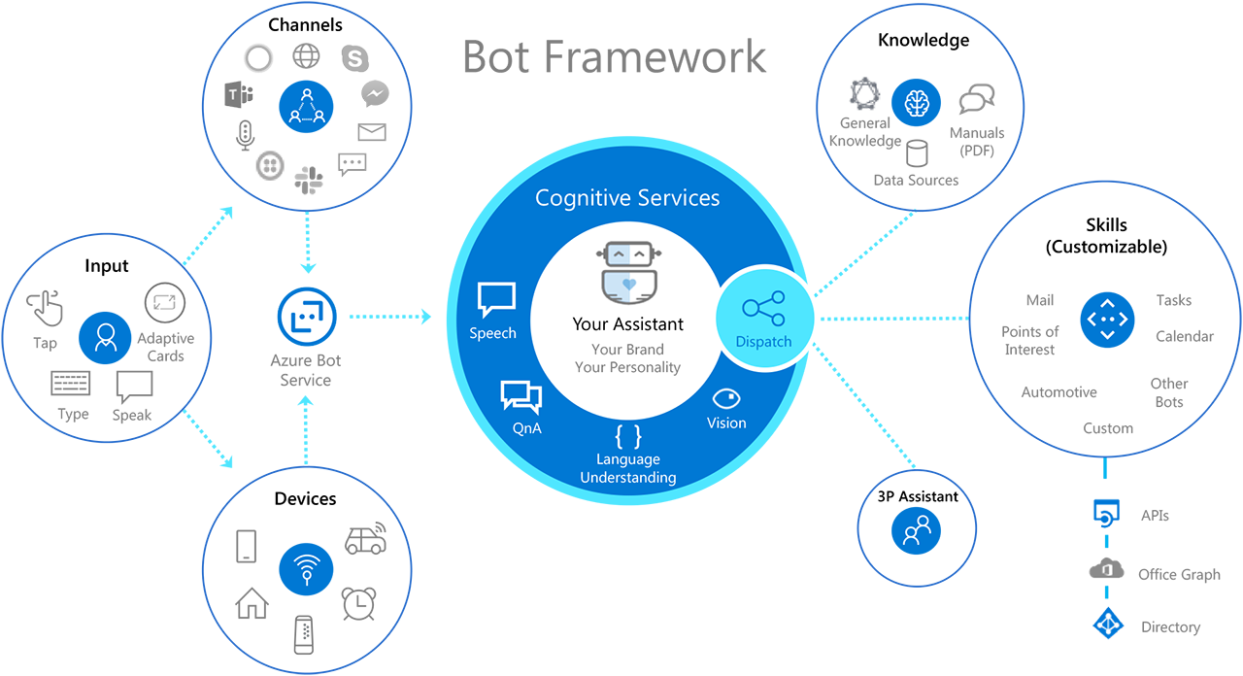

Slide 15
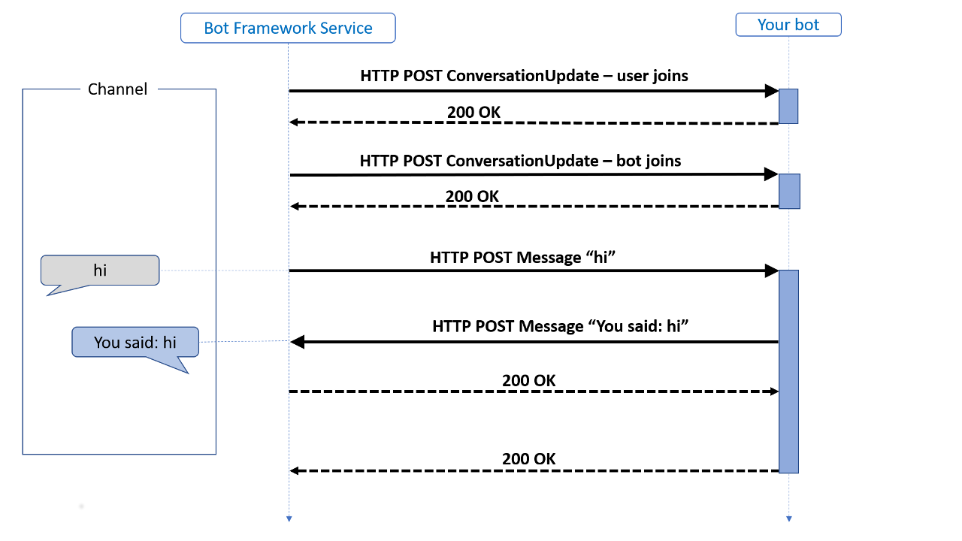
Bot Framework Service
https://docs.microsoft.com/en-us/learn/wwl-data-ai/build-chat-bot-azure-portal/media/bot-builder-activity.png

Slide 16
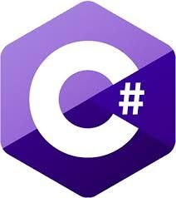


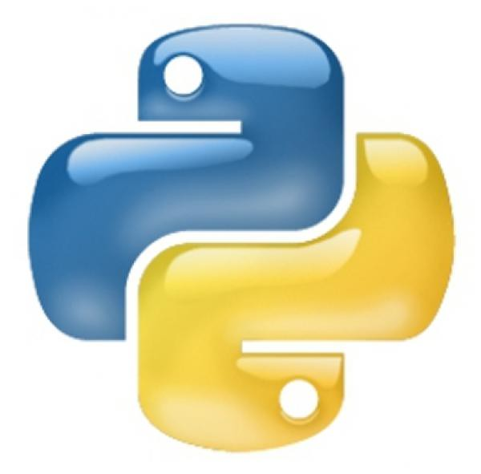


Bot Framework – Open Source Project
SDK v4
SDK v3
CLI Tools
Emulator
WebChat Control
Documentation
BotBuilder-Samples
This Photo by Unknown Author is licensed under CC BY-SA
This Photo by Unknown Author is licensed under CC BY-SA

Slide 17
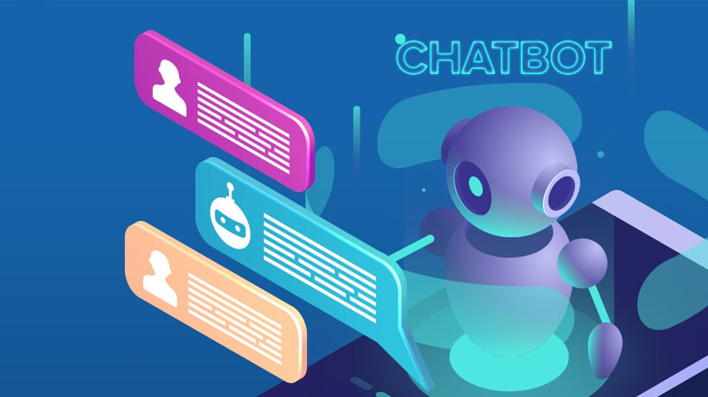
Bot Framework Composer

Slide 18
What can do with Composer?
Design and build conversional experiences
Visual authoring canvas for developer
Integrated language understating tools
LUIS
QnA Maker
Sophisticated composition of bot replies (Language Generation)
Open-source on GitHub
Cross-platform

Slide 19
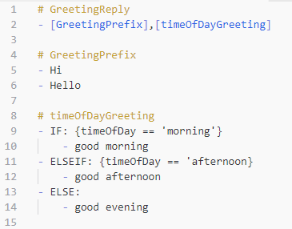
Language Generation
Generating Sophisticated Response
Example of a template that include composition reference to another template
Notes:
Markdown – lg file, new file format for language generation
Always start with #, and follow by -

Slide 20
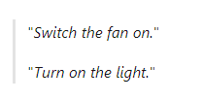
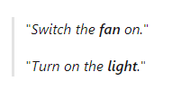
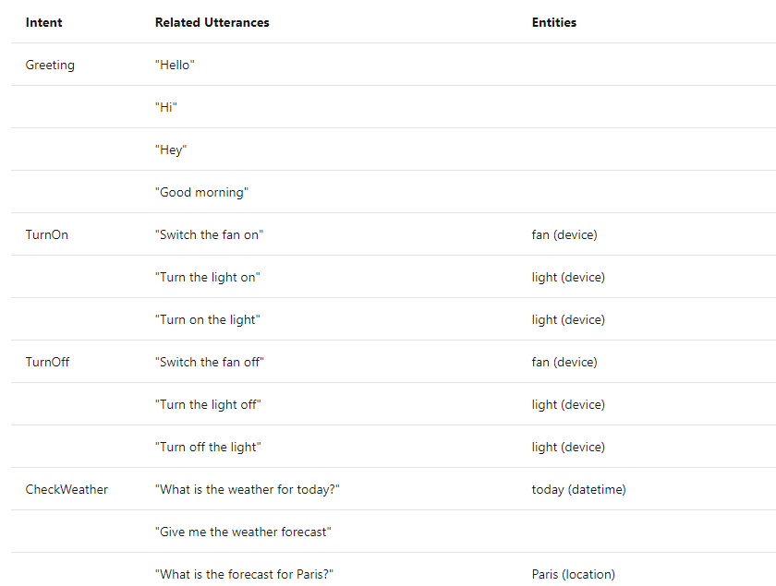
Language Understanding (LU)
Utterance – something that user might say
Entities - an item to which an utterance refers
Intents - represents the purpose, or goal, expressed in a user's utterance

Slide 21
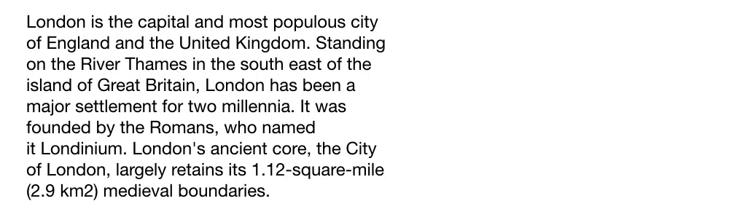
NLU Concept
https://medium.com/@ageitgey/natural-language-processing-is-fun-9a0bff37854e
Notes:
https://medium.com/@ageitgey/natural-language-processing-is-fun-9a0bff37854e

Slide 22
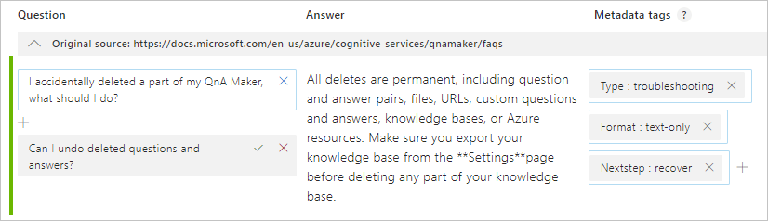
QnA Maker

Slide 23
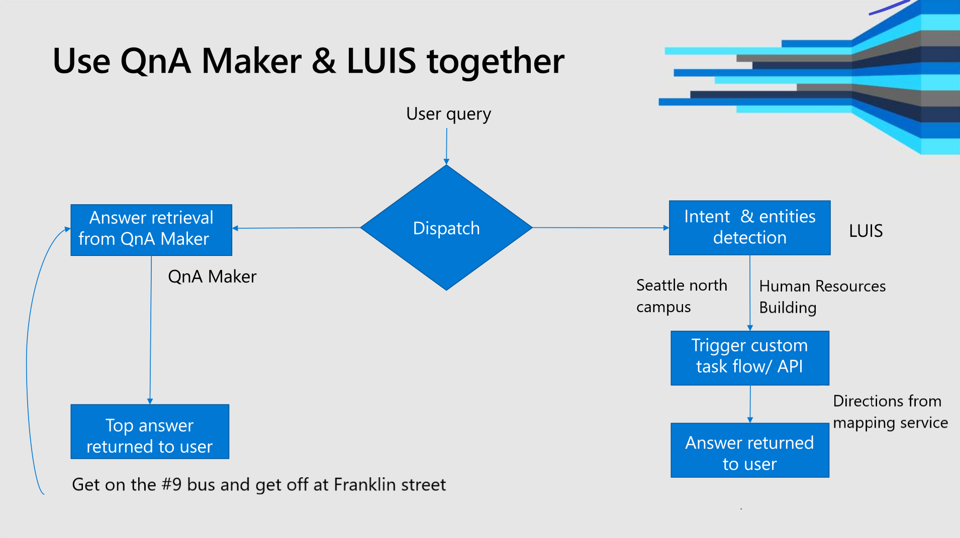
Notes:
Use NLP with QnA Maker for chat bots - Azure Cognitive Services | Microsoft Docs

Slide 24
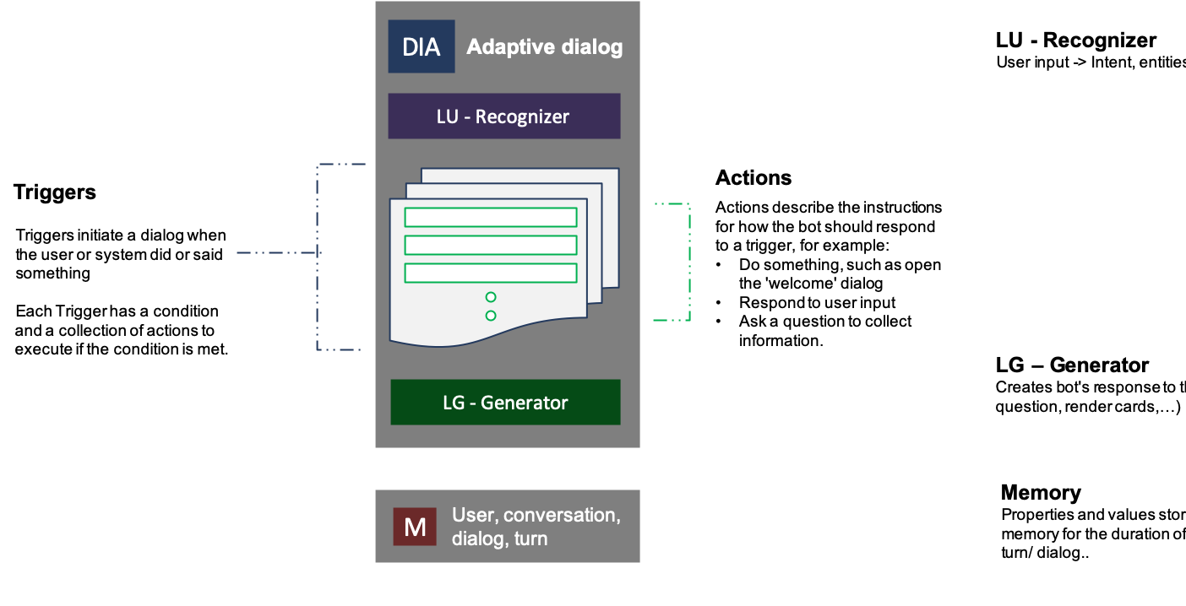
Notes:
Introduction to adaptive dialogs - Bot Service | Microsoft Docs

Slide 25
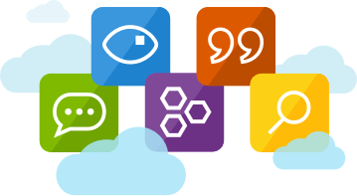
Add other services

Slide 26
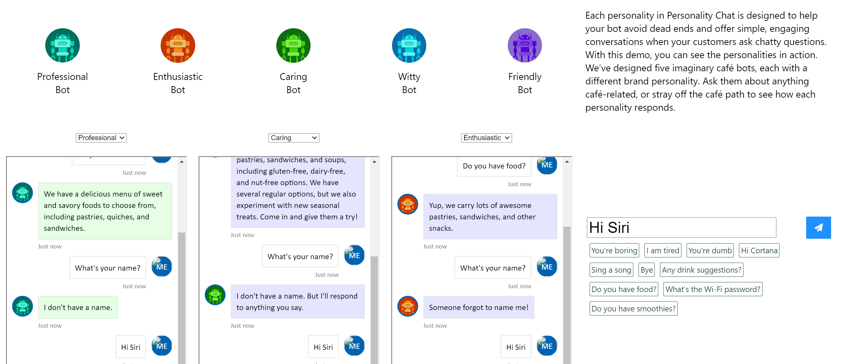
Personality Chat

Slide 27
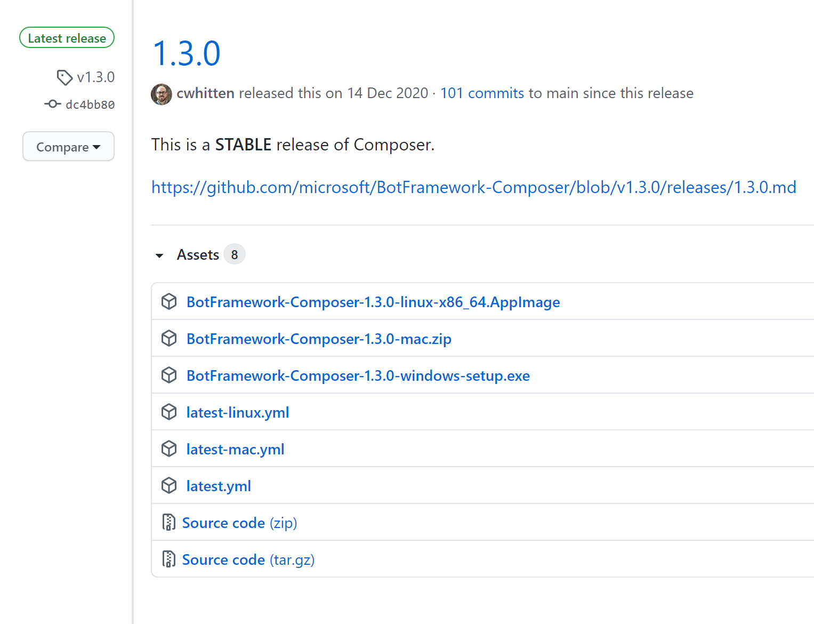
Start with Composer
.NET Core SDK 3.1
Bot Framework Emulator
Bot Framework Composer (Windows/macOS/Linux)

Slide 28
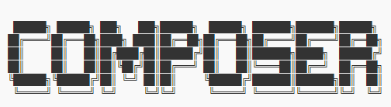
Build Composer Locally
Node.JS (v10, v12, v14)
Recommended architecture: x64
yarn install
yarn build
yarn startall

Slide 29

Host composer on your site
Azure Subscription
VM:
Node.js
NVM
Npm
Yarn
.NET Core
Host Composer as a web app - Bot Framework Composer | Microsoft Docs

Slide 30
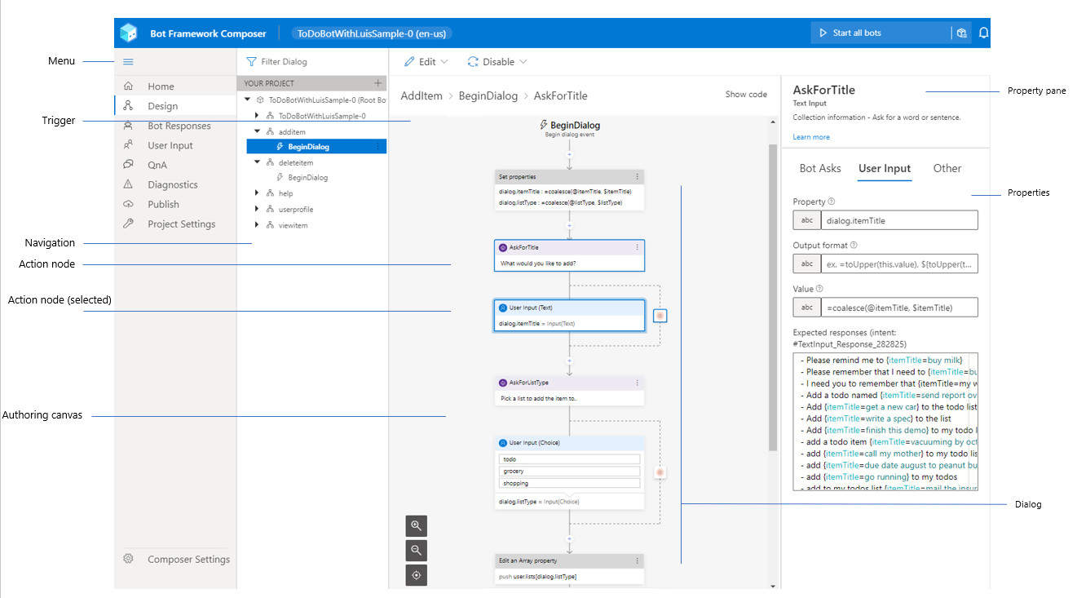
Notes:
https://aka.ms/bfcomposer

Slide 31
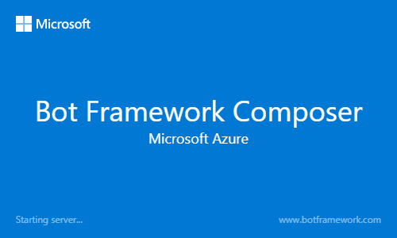
Demo
Bot Composer Overview
Notes:
Show Bot on web and bot on app

Slide 32
Resources
Bot Framework Composer Bot Framework Composer documentation | Microsoft Docs
Bot Emulator https://github.com/Microsoft/BotFramework-Emulator
QnAMaker https://www.qnamaker.ai/
Luis https://www.luis.ai/
MS Learn Create a Bot with the Bot Framework Composer - Learn | Microsoft Docs
Adaptive Cards Adaptive Cards

Slide 33
Thank you
gosiaborzecka.net
@gosiaborzecka
@gosia.ai

